Slide 1
Predictive analysis of pharmaceutical equipment
PIP104 University Project-II
Review-1
Batch Number: ISD-03
Under the Supervision of,
Dr. Sampath A K
Professor / Associate Professor / Assistant Professor
School of Computer Science & Engineering
Presidency University
ROLL NUMBER | STUDENT NAME
20211ISD0013 | MEDAM SIVAMANI
20211ISD0020 | PINNISETTY SUSMANTH
20211ISD0038 | MATLI MOKSHAGNI
Name of the Program: ISD
Name of the HoD: PALLAVI R
Name of the Program Project Coordinator: Mr.Srinivas Mishra
Name of the School Project Coordinators: Dr. Sampath A K / Dr. Abdul Khadar A / Mr. Md Ziaur Rahman

Slide 2
Introduction
In the pharmaceutical manufacturing industry, predictive analysis is essential for ensuring equipment efficiency and reliability. Utilizing predictive maintenance, along with sensors and tracking technologies, allows for continuous monitoring of machine operating conditions and performance. By analyzing this data, systems can forecast potential breakdowns and malfunctions before they occur, enabling timely preventive actions.
Moreover, predictive tools help manage parts inventories, monitor factory tooling, and oversee product quality, thereby minimizing the risk of failures and errors in pharmaceutical equipment. Such failures can significantly impact drug quality, highlighting the crucial role of predictive analysis in preserving the integrity of pharmaceutical production processes.
To enhance this process, I will be preparing a machine learning model to analyze the collected data and predict equipment performance and maintenance needs.

Slide 3
Literature Review
S.No | Author(s) | Title | Year | Methodology | Inferences | Merits | Demerits
1 | Smith, J., & Zhang, Y. | IoT-based Predictive Maintenance in Pharma Manufacturing | 2018 | IoT-based monitoring of equipment conditions | IoT sensors help identify early signs of equipment wear | Reduces maintenance costs | High initial setup costs
2 | Lee, K., & Sharma, R. | Machine Learning for Predictive Maintenance in Pharma | 2020 | ML models trained on historical maintenance data | ML models accurately predict equipment failure | Increases equipment uptime | Requires extensive historical data
3 | Patel, A., & Khan, M. | Data Analytics in Pharmaceutical Equipment Maintenance | 2019 | Data analytics for predicting machine downtime | Predictive analytics improve machine reliability | Minimizes unexpected breakdowns | Data privacy and security concerns

Slide 4
Literature Review
S.No | Author(s) | Title | Year | Methodology | Inferences | Merits | Demerits
4 | Gupta, S., & Lim, T. | Real-time Monitoring Systems for Pharmaceutical Production | 2021 | Sensor-based real-time data collection and analysis | Real-time data enhances response time to potential issues | Ensures continuous production flow | System complexity
5 | Wu, H., & Martin, L. | Predictive Inventory Management in Pharma | 2022 | Predictive tools for inventory and tooling management | Helps manage spare parts and reduce stock-outs | Reduces inventory costs | Complex implementation
6 | Chen, Q., & Silva, A. | Maintenance Optimization in Pharma Manufacturing | 2017 | Decision tree-based maintenance strategy | Optimizes maintenance scheduling | Improves equipment life span | High computational demands

Slide 5
Literature Review
S.No | Author(s) | Title | Year | Methodology | Inferences | Merits | Demerits
7 | Brown, M., & Singh, P. | AI-Driven Maintenance for Industrial Equipment | 2019 | AI algorithms for predictive maintenance | Early detection of equipment failure risks | Lowers overall maintenance expenses | Requires skilled personnel
8 | Thompson, J., & Rivera, C. | Big Data Applications in Pharmaceutical Production | 2020 | Big data analytics applied to equipment performance | Informs maintenance decisions based on data trends | Leverages large datasets | High data storage and processing costs
9 | Gonzalez, R., & Yamada, T. | Sensor-Based Predictive Maintenance in Pharmaceuticals | 2021 | Condition monitoring with sensor networks | Sensors detect abnormal conditions early | Ensures production continuity | Installation challenges

Slide 6
Proposed Method
The proposed method focuses on implementing a comprehensive predictive maintenance system that leverages data collected from various sensors to forecast equipment failures and improve operational efficiency. The approach consists of several key phases:
1. System Design and Requirements Gathering
2. Data Acquisition
3. Data Storage and Management
4. Data Preprocessing
5. Predictive Modeling
6. Real-Time Monitoring and Alerting7. Integration with Inventory Management
8. Pilot Testing and Validation

Slide 7
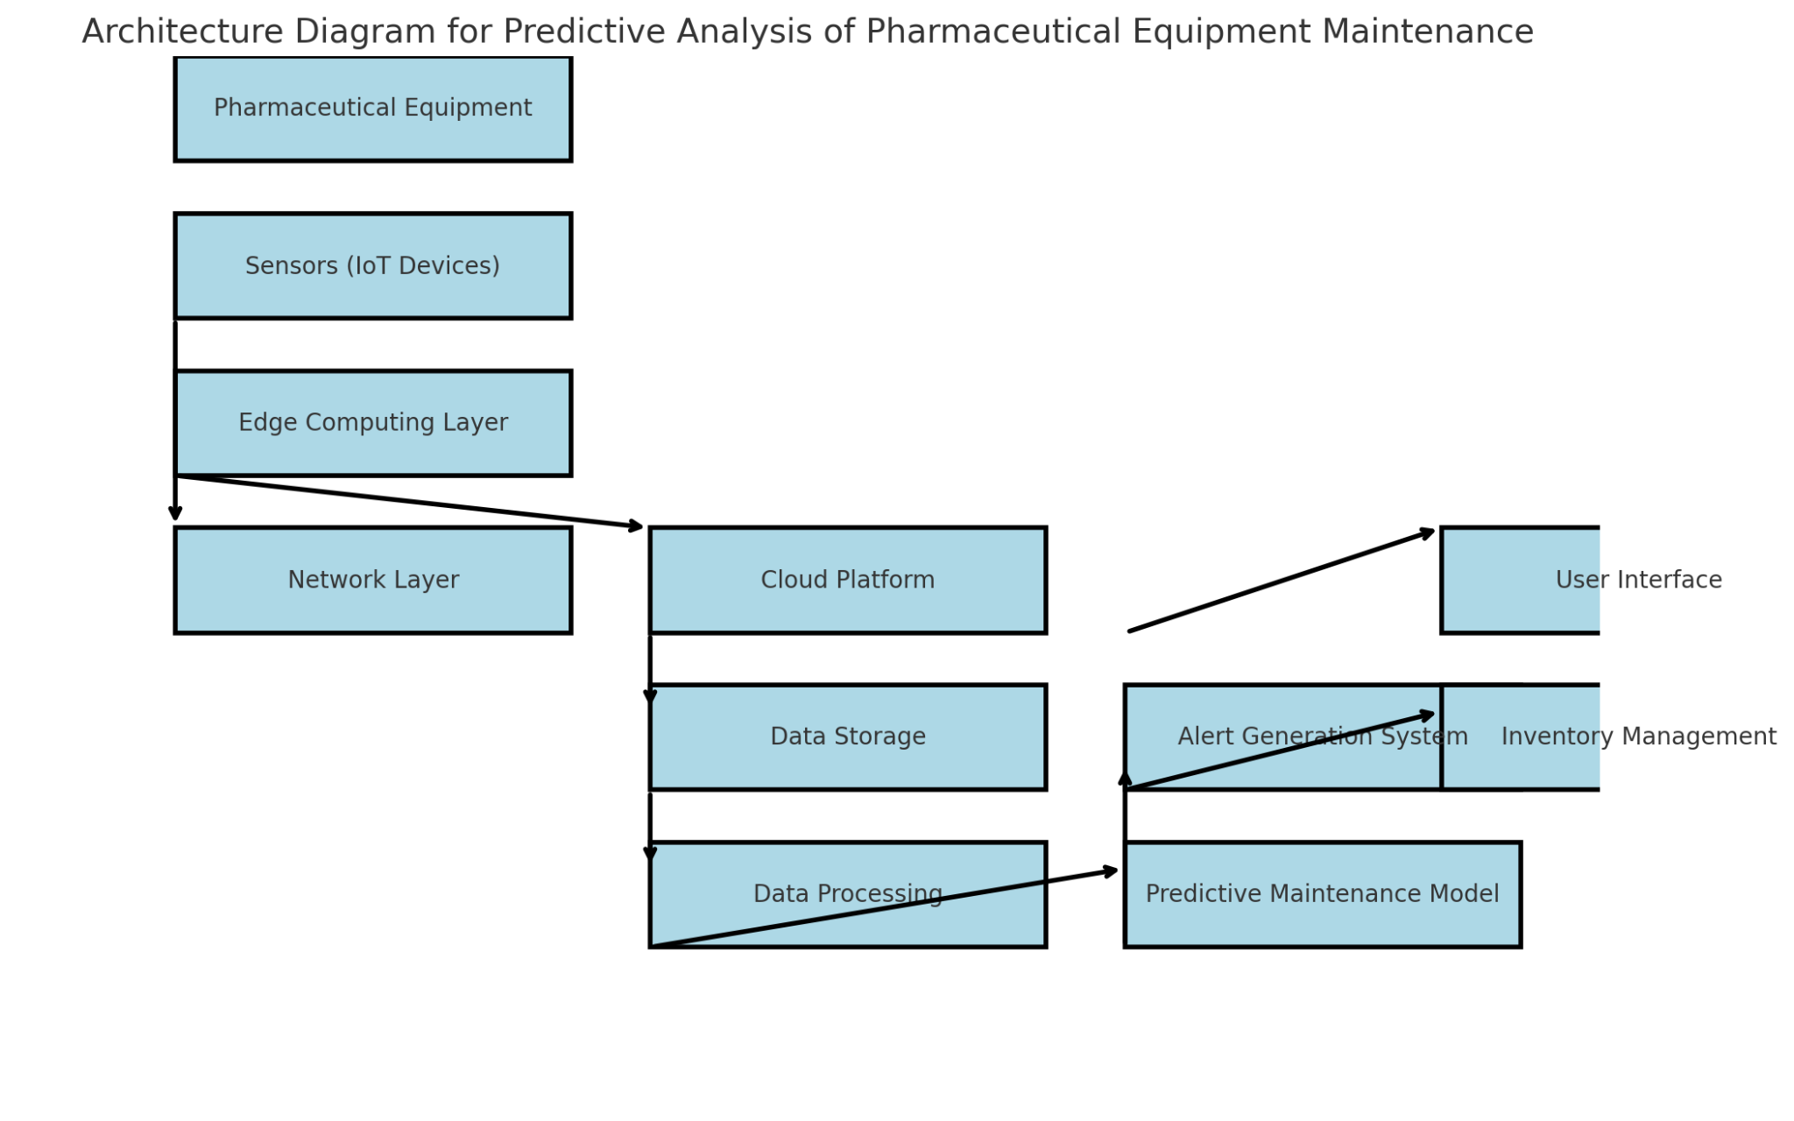
Architecture Diagram

Slide 8
Modules
Data Processing and Preprocessing
Objective: To clean and prepare the collected data for machine learning model development.
Tasks:
Handle missing values, outliers, and noisy data to ensure clean datasets.
Normalize or standardize data to ensure uniformity in different parameters.
Predictive Model Development
Objective: To develop machine learning models capable of predicting equipment failures and recommending maintenance actions.
Tasks:
Select appropriate machine learning algorithms (e.g., Random Forest, SVM, Neural Networks) for predictive maintenance.
Real-Time Monitoring and Analytics Dashboard
Objective: To create a user-friendly interface for monitoring equipment health, performance metrics, and predictive maintenance alerts.
Tasks:
Design a real-time dashboard using tools like Grafana, Tableau, or Power BI for visualizing sensor data.
Develop a system for monitoring equipment status and displaying key parameters such as temperature, pressure, and vibration.
Inventory and Resource Management
Objective: To link predictive maintenance with inventory systems to ensure the availability of spare parts and resources when needed.
Tasks:
Integrate the predictive maintenance system with existing inventory management software.

Slide 9
Modules
Pilot Testing and System Validation
Objective: To validate the effectiveness of the predictive system in a real-world manufacturing environment.
Tasks:
Conduct a pilot test on selected equipment in the pharmaceutical production line.
Monitor the system’s accuracy in predicting breakdowns and malfunctions.
Gather feedback from operators and maintenance teams regarding system usability and performance.
Make necessary adjustments to improve the accuracy of predictions and system integration.
Full-Scale Deployment and Maintenance
Objective: To deploy the predictive maintenance system across all relevant pharmaceutical equipment and ensure its smooth operation.
Tasks:
Implement the system across the entire manufacturing facility, ensuring that all critical machines are monitored.
Train staff on how to use the system, interpret data, and respond to alerts.
Establish a maintenance schedule based on predictive insights to minimize unexpected equipment failures.
Perform continuous system monitoring and regular updates to improve performance.
These modules ensure a comprehensive, step-by-step approach to successfully implementing predictive analysis for pharmaceutical equipment, helping to reduce downtime, maintain product quality, and optimize resource management.

Slide 10
Hardware and Software Details
Hardware and Software Details
Hardware Requirements
Processor: Multi-core (e.g., Intel Xeon, AMD Ryzen)
RAM: Minimum 16 GB
Storage: SSD, at least 512 GB
Network: High-speed internet (100 Mbps or more)
IoT Sensors
Edge Devices
Software Requirements
Operating System: Windows Server
Programming Languages:
Development Tools:
TensorFlow / Keras: For developing and training predictive maintenance models using deep learning.
Frontend: React Native or Flutter for mobile app development.
Machine Learning:
Libraries: Scikit-learn for basic algorithms; TensorFlow for advanced models (if needed).
Database:
Options: MySQL or PostgreSQL (SQL) for structured data, and MongoDB (NoSQL) for unstructured data.

Slide 11
Objectives
The main objectives of implementing predictive analysis in pharmaceutical equipment maintenance are as follows:
Minimize Equipment Downtime:
To proactively predict and prevent equipment malfunctions, thereby reducing unplanned downtime and ensuring continuous pharmaceutical production.
Enhance Equipment Lifespan:
To optimize the performance of manufacturing equipment by addressing maintenance needs before significant wear and tear occur, extending the operational life of machines.
Ensure Consistent Product Quality:
To maintain high product quality standards by monitoring key machine parameters that directly affect drug manufacturing processes, ensuring compliance with pharmaceutical regulations.
Improve Maintenance Efficiency:
To shift from reactive to predictive maintenance, ensuring that maintenance tasks are performed only when necessary, resulting in cost savings and efficient resource utilization.
Optimize Inventory Management:
To streamline spare parts inventory by predicting when specific components will need replacement, preventing overstocking or shortages of critical parts.
Reduce Operational Costs:
To lower overall maintenance costs through early detection of equipment failures and minimizing production halts, leading to improved profitability.

Slide 12
Methodology
The methodology for implementing predictive analysis in pharmaceutical equipment maintenance involves a systematic approach, integrating data collection, machine learning models, and real-time monitoring. The following steps outline the methodology:
1. System Design and Planning
Objective Definition: Identify key goals for the predictive maintenance system, such as minimizing equipment downtime, improving product quality, and optimizing resource management.
2. Data Collection and Sensor Installation
Sensor Deployment: Install IoT-enabled sensors on selected equipment to monitor key performance indicators (KPIs) such as machine temperature, pressure, vibrations, motor speeds.
3. Data Preprocessing
Data Cleaning: Remove outliers, noise, or irrelevant data points to ensure the quality of the input data. Handle missing values through interpolation or imputation techniques.
4. Model Development
Algorithm Selection: Use machine learning algorithms such as Random Forest, Support Vector Machines (SVM), or neural networks to build the predictive models. These algorithms will identify patterns in the data that correlate
5. System Integration
6. Pilot Testing and Validation

Slide 13
Timeline of Project
Phase 1: Research and Planning (Weeks 1-2)
Review existing literature on predictive analysis and its application in pharmaceutical manufacturing.
Identify key sensors, equipment, and parameters to monitor (e.g., temperature, pressure, vibration).
Phase 2: Data Collection Setup (Weeks 3-5)
Install and configure sensors on critical pharmaceutical manufacturing equipment.
Set up IoT devices and monitoring systems for real-time data capture.
Phase 3: Model Development and Training (Weeks 6-8)
Develop machine learning models using collected data to predict equipment failures and malfunctions.
Train models on historical data to recognize patterns of failure or performance degradation.
Phase 4: Implementation of Predictive Analytics System (Weeks 9-10)
Integrate predictive models into the maintenance system.
Phase 5: Testing and Evaluation (Weeks 11-12)
Conduct a pilot run to test the predictive analytics system on selected equipment.
Phase 6: Full-Scale Deployment (Weeks 13-15)
Roll out the predictive maintenance system across all relevant equipment in the facility.
Phase 7: Performance Monitoring and Optimization (Weeks 16-18)

Slide 14
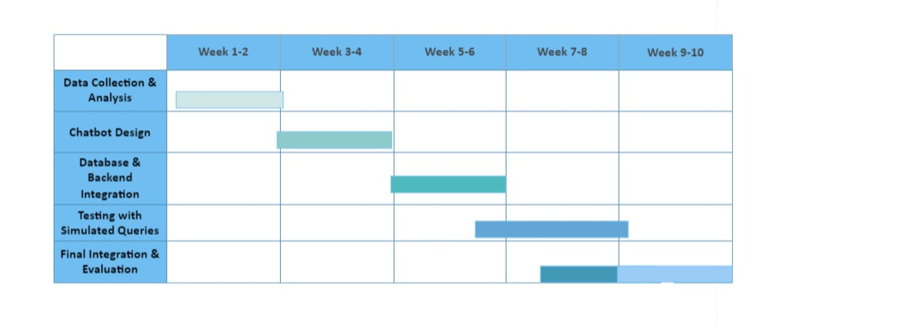
Gantt Chart

Slide 15
Expected Outcomes
The implementation of predictive analysis in pharmaceutical equipment maintenance is expected to yield several positive outcomes:
Reduction in Equipment Downtime: Predictive maintenance will allow early detection of potential breakdowns, reducing unplanned downtime and ensuring continuous production.
Improved Equipment Longevity: By addressing issues before they escalate, predictive analysis will prolong the lifespan of manufacturing equipment, leading to reduced replacement costs.
Enhanced Product Quality: Monitoring critical machine parameters will ensure consistent drug production quality, minimizing the chances of defects and ensuring compliance with regulatory standards.
Optimized Inventory Management: Predictive systems will help track the usage and wear of parts, enabling efficient inventory management by ensuring that spare parts are available when needed, reducing delays caused by lack of components.
Cost Savings: The reduction in downtime, improved equipment performance, and optimized resource management will collectively lower operational costs.
Regulatory Compliance: By maintaining stringent control over equipment conditions and product quality, predictive analysis will help manufacturers meet regulatory requirements and reduce the risk of non-compliance.
Increased Operational Efficiency: With smoother production processes and fewer interruptions, the overall operational efficiency of the pharmaceutical manufacturing plant will improve, enhancing productivity and profitability.

Slide 16
Conclusion
Predictive analysis has proven to be a transformative tool in pharmaceutical manufacturing, ensuring both the reliability of equipment and the consistent quality of drug products. By utilizing real-time data from sensors, machine learning algorithms, and predictive maintenance strategies, manufacturers can anticipate equipment breakdowns and take preventive measures before malfunctions occur. This proactive approach reduces unplanned downtime, optimizes inventory management, and ensures seamless production processes. Moreover, by monitoring and controlling the critical operating conditions of machines, predictive analytics safeguards the quality of pharmaceutical products, thereby minimizing the risk of regulatory non-compliance and enhancing patient safety. Ultimately, the integration of predictive analysis in pharmaceutical manufacturing strengthens operational efficiency, reduces costs, and ensures the integrity of the final products.

Slide 17
References
[1] Settembrini P, Sultan S, Settembrini A. Pioneering a Healthier Future: Advancements in Vascular Biomaterials,
Synthetic Vascular Neuronal Networks, and Precision Vascular Medicine. Frontiers in Surgery.;10:1293094.
[2] Campuzano S, Barderas R, Moreno-Casbas MT, Almeida Á, Pingarrón JM. Pursuing precision in medicine and
nutrition: the rise of electrochemical biosensing at the molecular level. Analytical and Bioanalytical Chemistry. 2023
Jul 7:1-22.
[3] Manchadi O, Ben-Bouazza FE, Jioudi B. Predictive Maintenance in healthcare system: A Survey. IEEE Access. 2023
Jun 19.
[4] Houssein EH, Hosney ME, Emam MM, Younis EM, Ali AA, Mohamed WM. Soft computing techniques for
biomedical data analysis: open issues and challenges. Artificial Intelligence Review. 2023 Aug 31:1-51.
[5] Bharadiya JP. Leveraging Machine Learning for Enhanced Business Intelligence. International Journal of Computer
Science and Technology. 2023 Jul 6;7(1):1-9.
[6] Raziee Z. Artificial Intelligence and Machine Learning as an Antifragile Driver in the Supply Chain. International
Journal of Industrial Engineering and Operational Research. 2023 Aug 30;5(1):60-8.
[7] Himeur Y, Elnour M, Fadli F, Meskin N, Petri I, Rezgui Y, Bensaali F, Amira A. AI-big data analytics for building
automation and management systems: a survey, actual challenges and future perspectives. Artificial Intelligence
Review. 2023 Jun;56(6):4929-5021.

Slide 18
Thank You

